Slide 1
雅思听力基础能力训练
后附练习答案

Slide 2
Basic Listening Ability:
Listening for specific information
Question Types:
Form filling
Table completion

Slide 3
You need to read the form or table carefully before listening and determine the specific type of information that’s missing.
The types of information include but are not limited to: names, numbers, reasons, nouns, adjectives...

Slide 4


Activity No.1
You will hear a dialogue. As you listen, fill in the form below.
1._____________________________
2._____________________________
3._____________________________
4._____________________________
5._____________________________
6._____________________________
7._____________________________
Family name
First name
Length of English study
Examinations passed
Score
Subjects needing help
Biggest problem
Notes:
03/12/2022: (dd/mm/yyyy)
Riley (o) Riley
Peter (o) Peter
6 (x) 6 years
ILETS (x) IELTS
6 (o) 6
listening writing (x) listening writing speaking
speak (x) speaking

Slide 5


Activity No.2
You will hear a dialogue. As you listen, fill in the form below.
1._____________________________
2._____________________________
3._____________________________
4._____________________________
5._____________________________
6._____________________________
7._____________________________
Which subject put first
Reasons
Second
Third
Fourth
Which subjcct put last
Reasons
Notes:
#### slide 5 03/12/2022
computer science (o) Computer Science
popular easy to find a job well paid effect (o)
math (x) medicine
dentist (x) dentistry
engineering (o) engineering
arts (o) Arts
no talent (o)

Slide 6


Activity No.3
You will hear two telephone conversation. As you listen, fill in the form below.
1._____________________________
2._____________________________
3._____________________________
4._____________________________
5._____________________________
Receiver's tclephone No.
Receiver's name
Reason for phoning
What will they do
When will they do it

Slide 7
Activity No. 3
You will hear two telephone conversation. As you listen, fill in the form below.
Receiver's telphone No.
Caller's name
Receiver's name
Why can't they meet on Friday
Why can't they meet on Saturday
1._____________________________
2._____________________________
3._____________________________
4._____________________________
5._____________________________

Slide 8
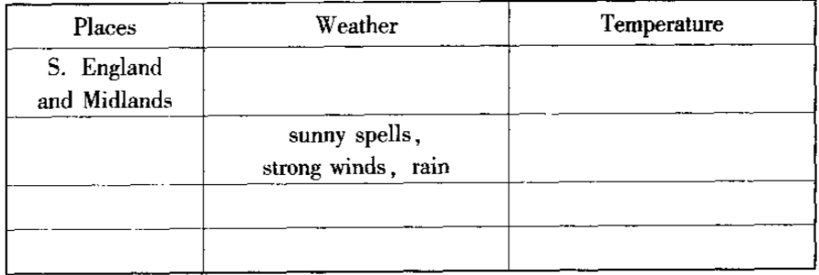
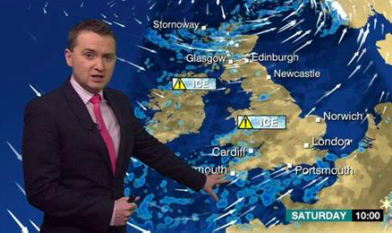
Activity No. 4
You will hear the BBC weather forecast. As you listen, fill in the missing information in the correct column.

Slide 9
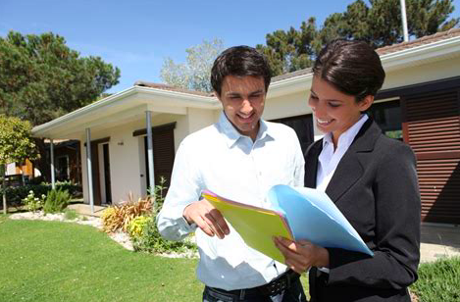

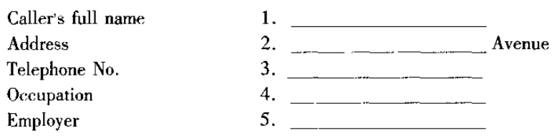
Activity No. 5
A man is looking for a new flat. He is talking to an estate agent. Listen carefully and fill in the form below.

Slide 10
Activity No. 6
Listen to a conversation between a landlord and a tenant. Imagine you are the tenant. Listen carefully and fill in the form below.
Is the room available?
Number of beds in the room
Facilities to be shared with others Number of people who are sharing the facilities now
Is there a phone in the house?
Can the tenants make calls in the house?
The rent
The rent is due
The first month's payment
Telcphone number
1._____________________________
2._____________________________
3._____________________________
4._____________________________
5._____________________________
6._____________________________
7._____________________________
8._____________________________
9._____________________________
10._____________________________

Slide 11
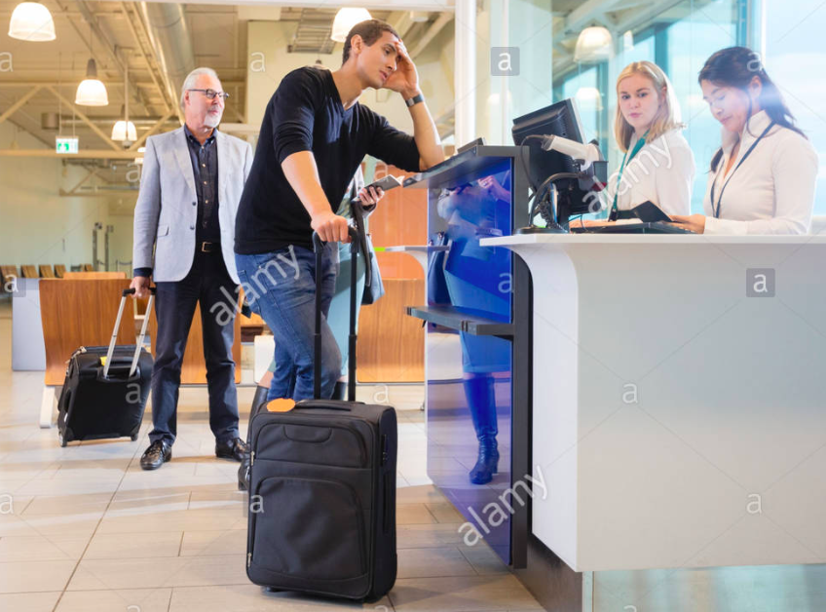
Activity No. 7
You will hear a conversation at the customs in Gatwick Airport. As you listen, fill in the form below.
1._____________________________
2._____________________________
3._____________________________
4._____________________________
5._____________________________
6._____________________________
7._____________________________
Sumame
First name
Sex
Dale of birth
Nationality
Occupation
Reason for travel in the UK
Address in the UK

Slide 12
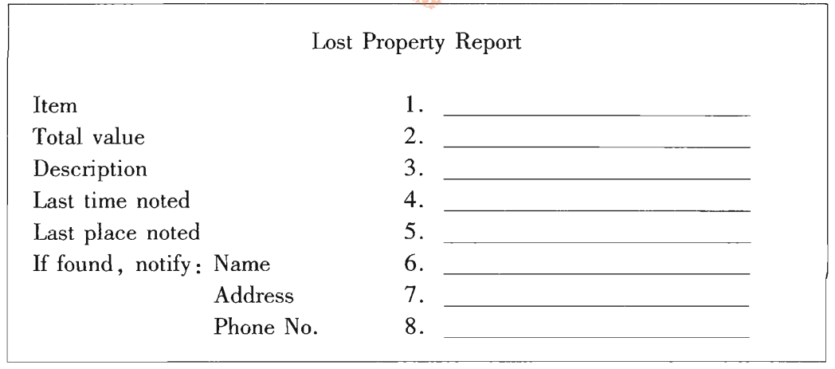


Activity No.8
You’re a member of the staff in a lost property office in a department store. A woman comes to your office to report that she has lost something. As you listen, fill in the report form with the information she gives you.

Slide 13
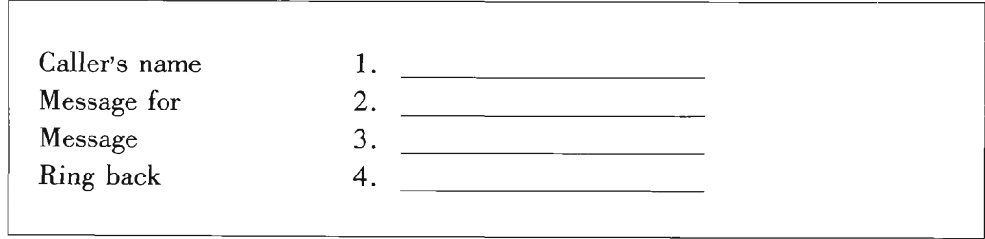
Activity No. 10
You will hear four telephone messages. As you listen,
write down the important information given by the callers.
Message 1

Slide 14

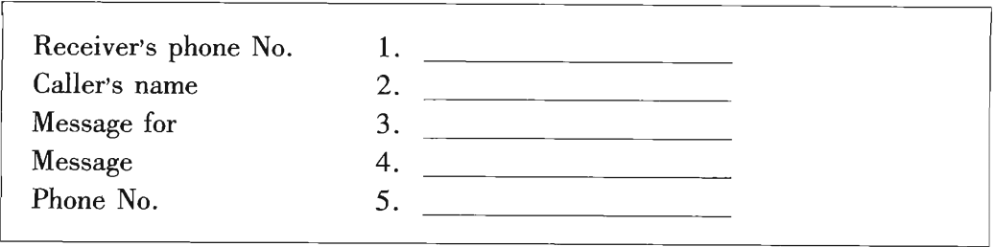
Activity No. 10
You will hear four telephone messages. As you listen, write down the important information given by the callers.
Message 2

Slide 15
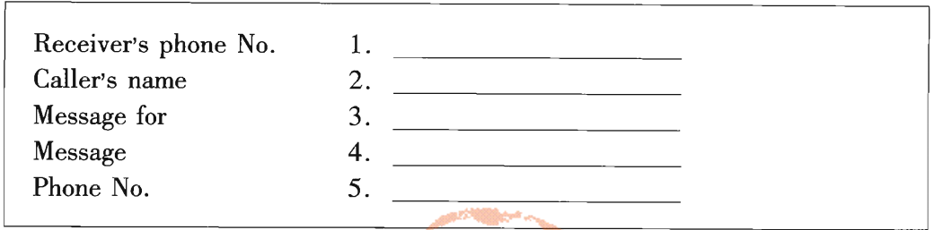
Activity No. 10
You will hear four telephone messages. As you listen, write down the important information given by the callers.
Message 3

Slide 16
Activity No. 10
You will hear four telephone messages. As you listen, write down the important information given by the callers.
Message 4

Slide 17
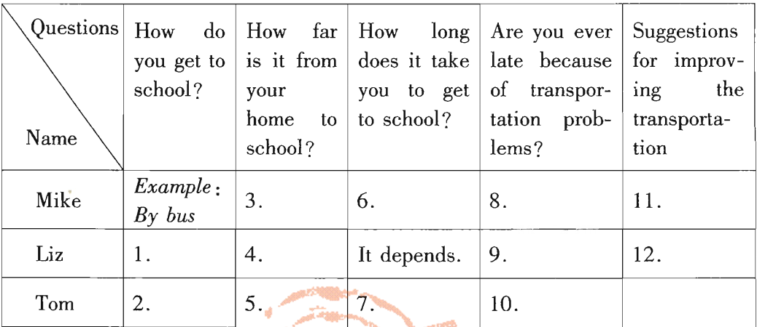

Activity No. 11
You are going to hear an interview on transportation. As you listen, fill in the form below.

Slide 18
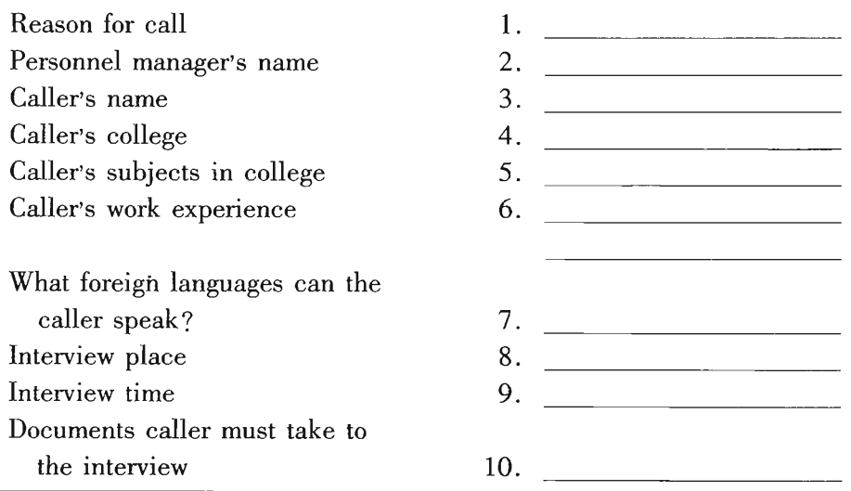

Activity No. 12
You will hear a conversation. As you listen,
fill in the missing information in the form below.

Slide 19
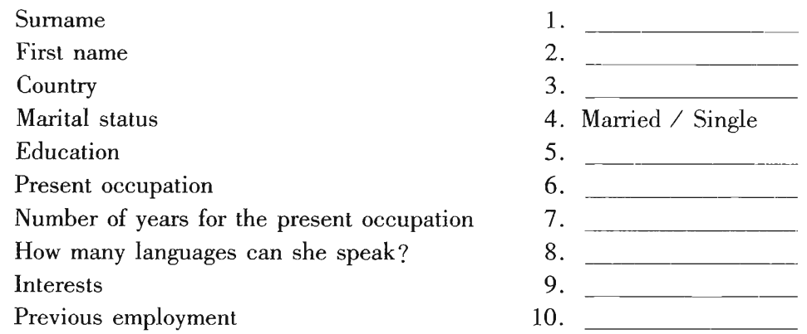
Activity No. 13
You will hear an interview. As you listen, fill in the form about Miss Wood.

Slide 20
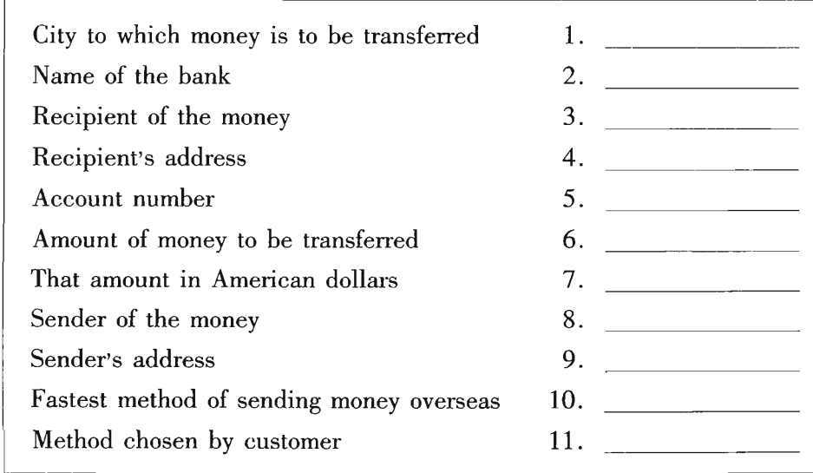
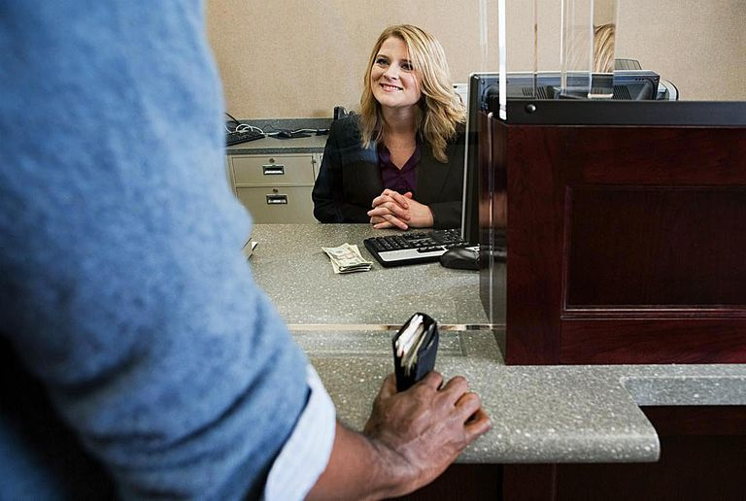
Activity No. 14
You will hear a dialogue between a bank officer and a customer. As you listen, fill in the form below.

Slide 21
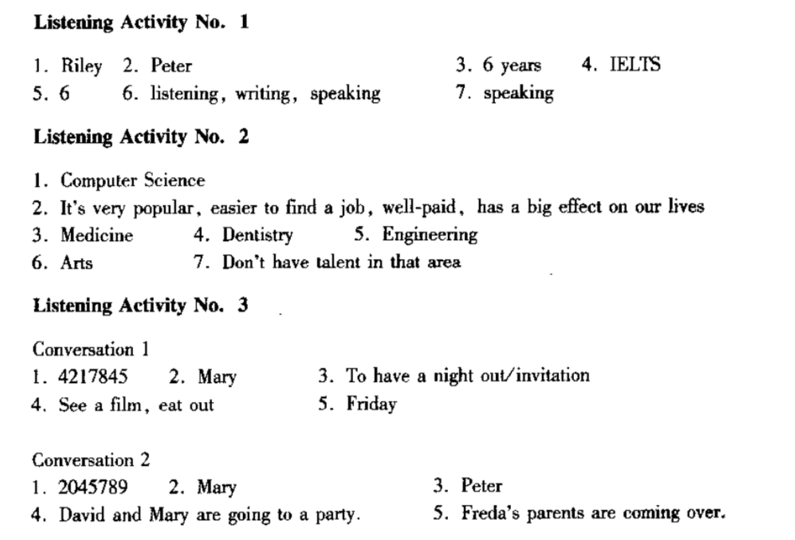

Slide 22
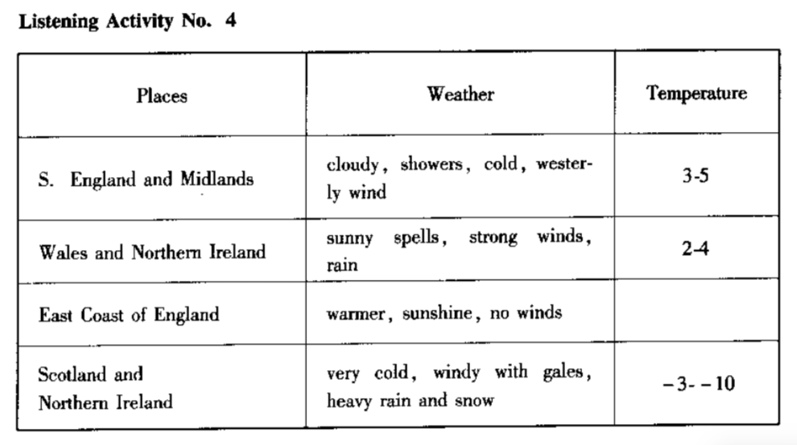

Slide 23
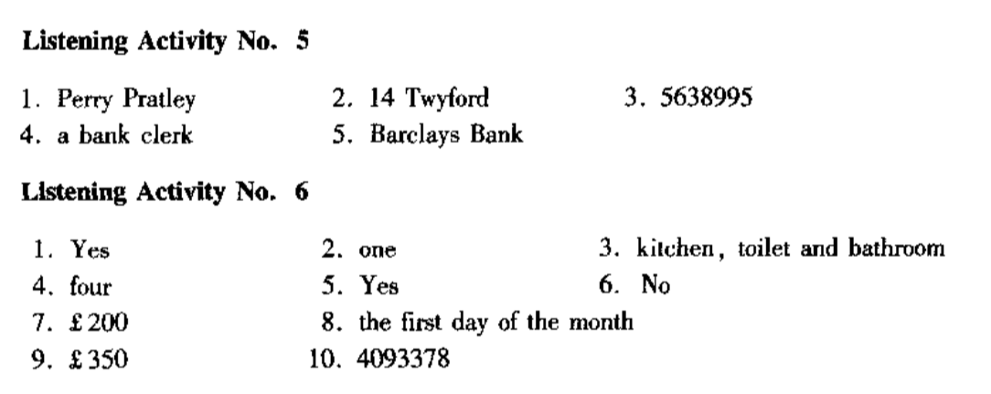

Slide 24
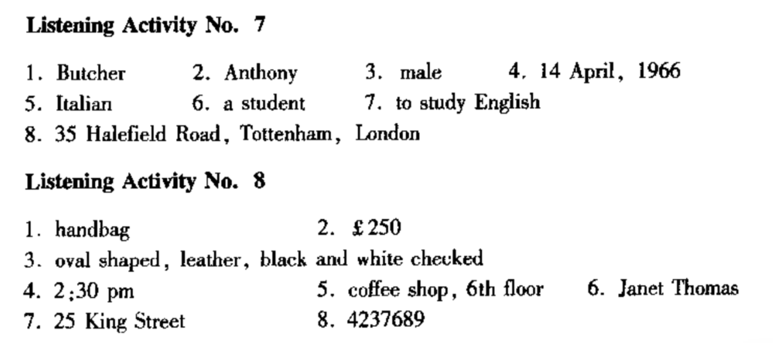

Slide 25
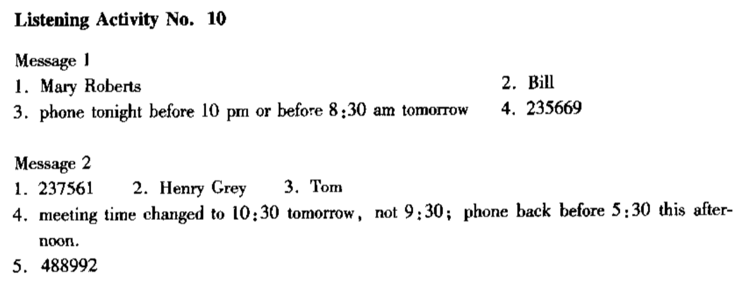
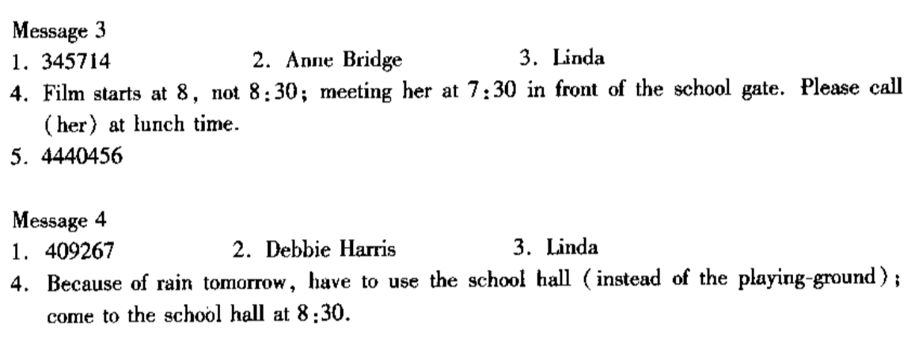

Slide 26
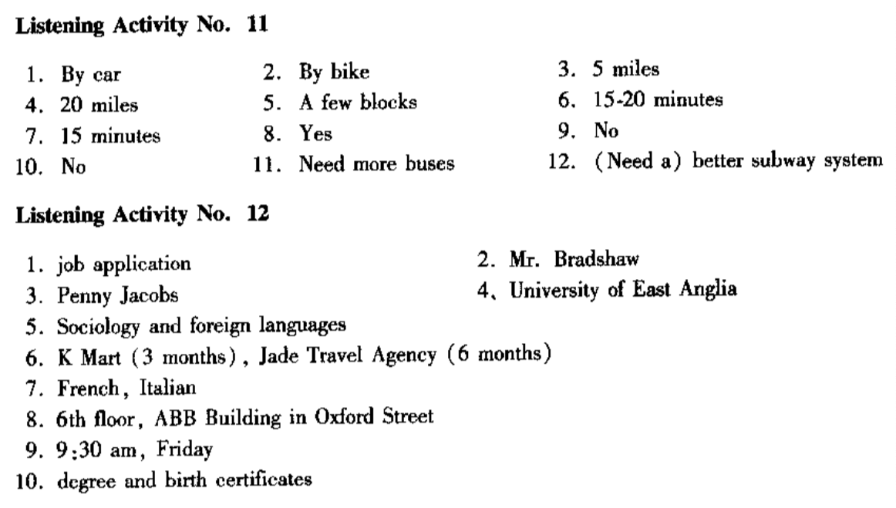

Slide 27
